Slide 1
South Carolina Retirement System Solvency Analysis
Prepared by:Pension Integrity Project at Reason Foundation. 2022—Preliminary Draft

Slide 2
About the Pension Integrity Project
We offer pro-bono technical assistance to public officials to help them design and implement pension reforms that improve plan solvency and promote retirement security, including:
Customized analysis of pension system design, trends
Independent actuarial modeling of reform scenarios
Consultation and modeling around custom policy designs
Latest pension reform research and case studies
Peer-to-peer mentoring from state and local officials who have successfully enacted pension reforms
Assistance with stakeholder outreach, engagement and relationship management
Design and execution of public education programs and media campaigns

Slide 3
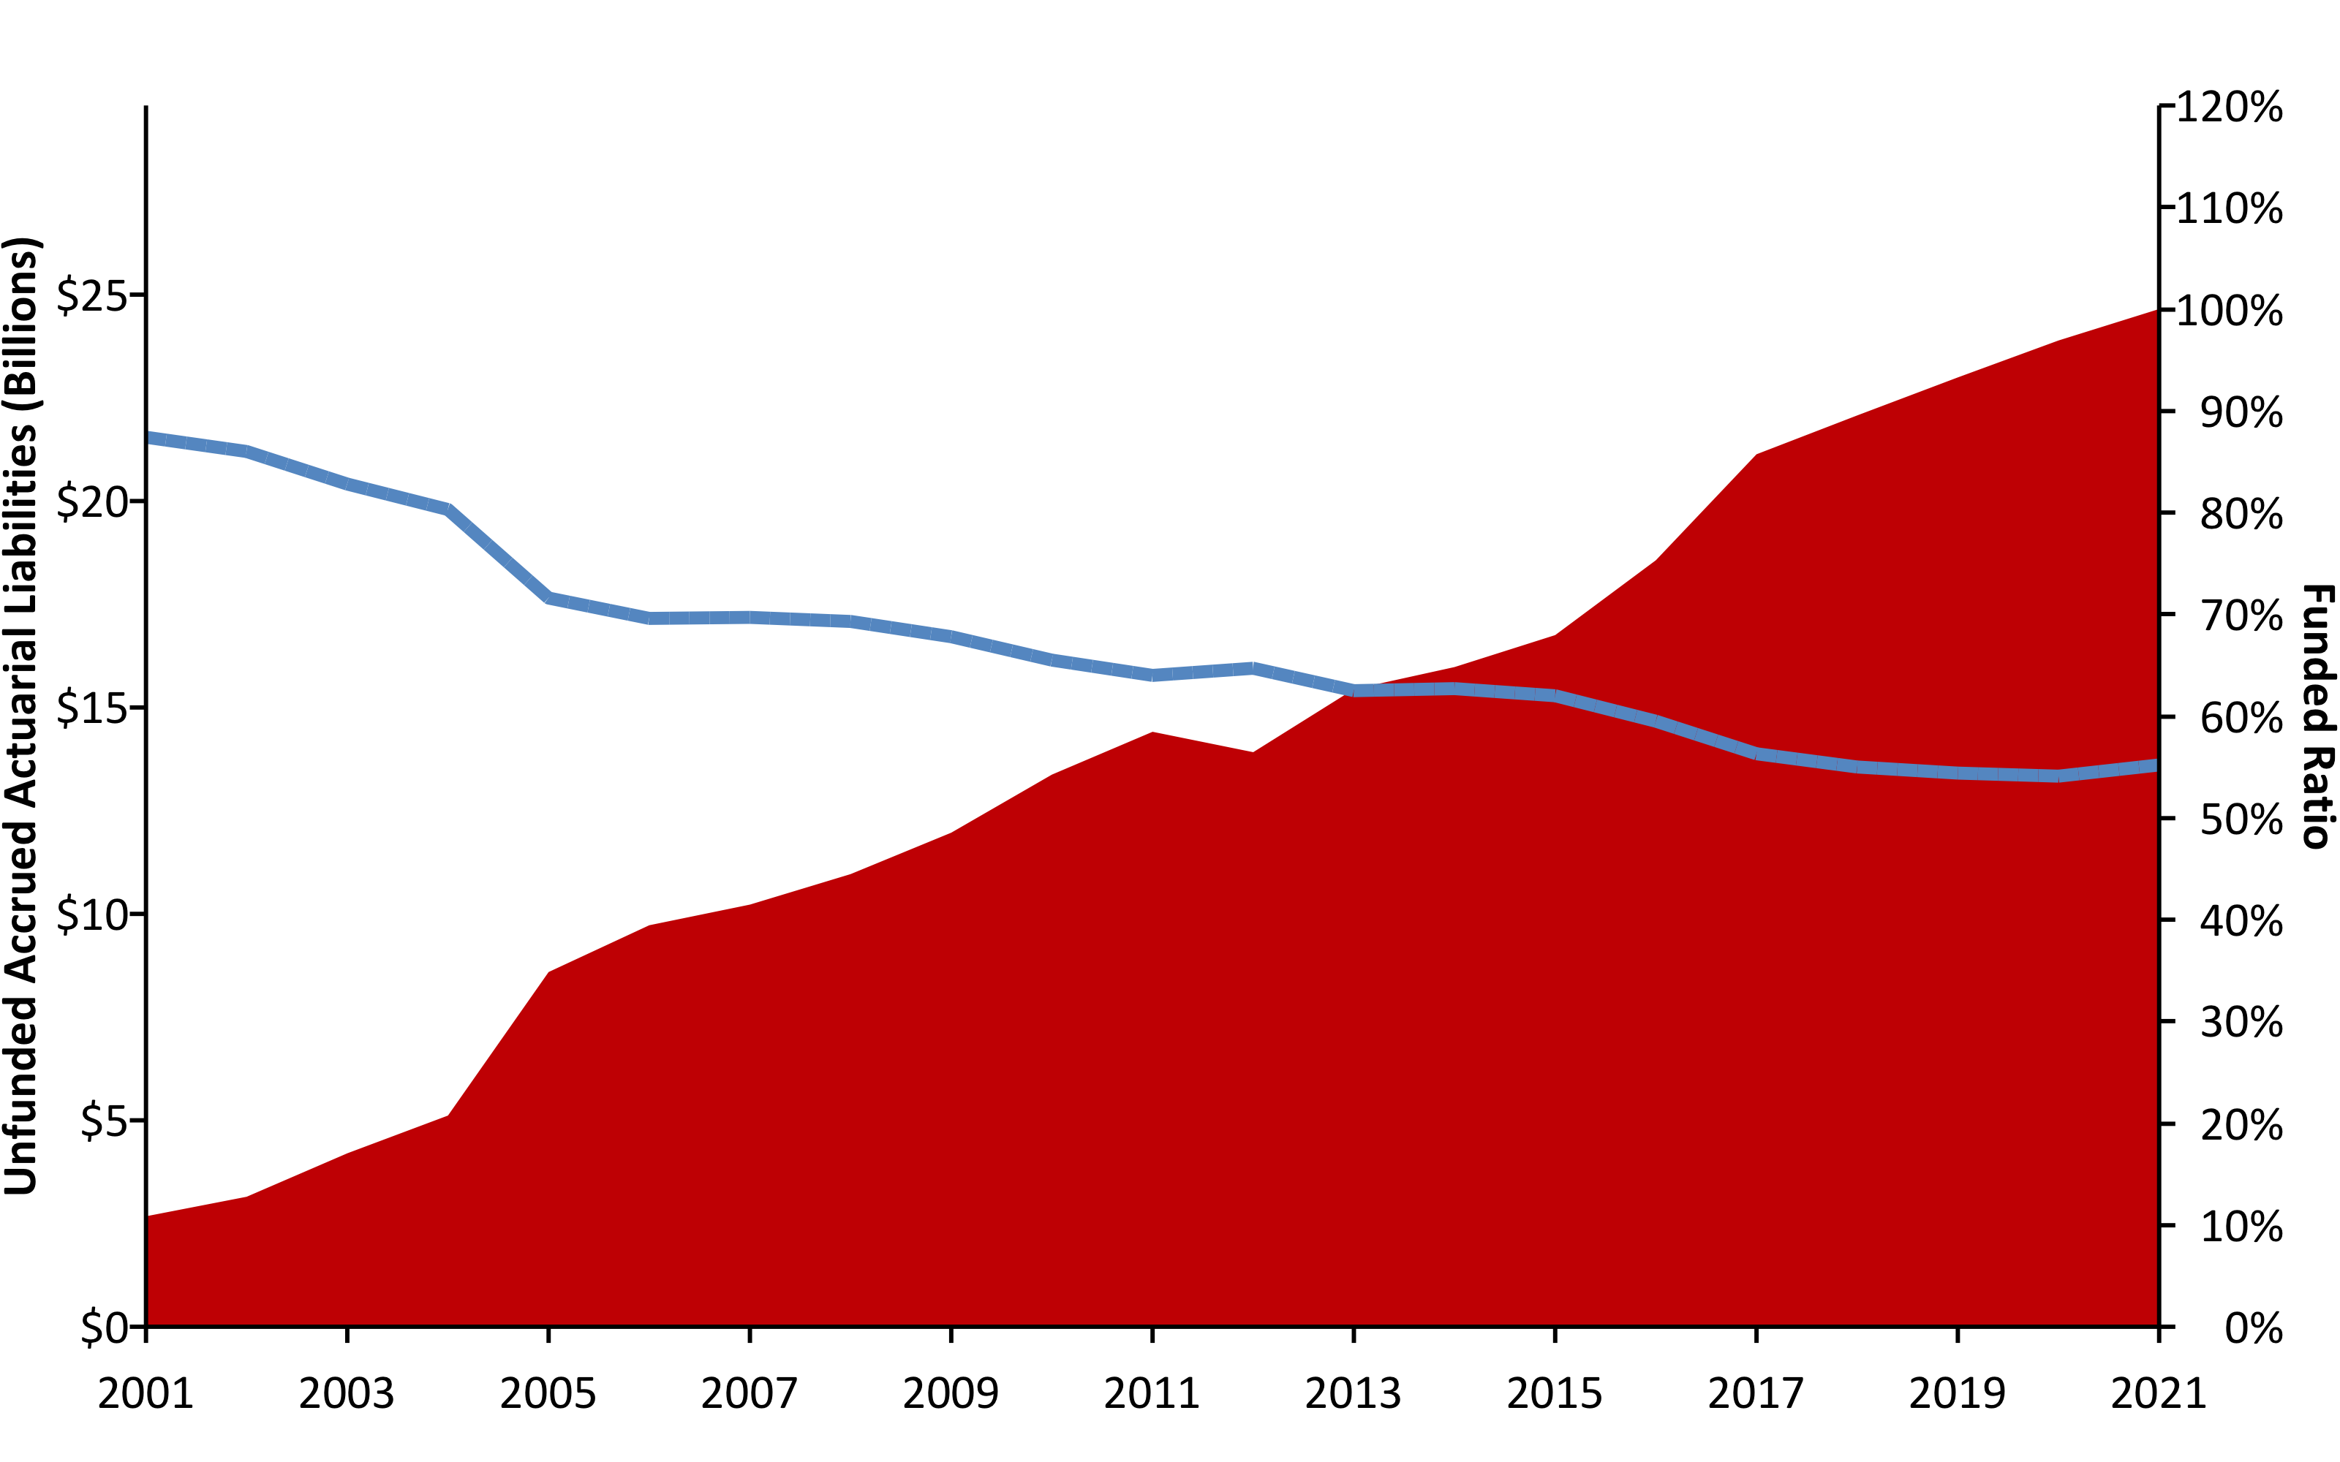
SCRS Unfunded Liabilities (2001-2021) w/ R (areaPlot())
Source: Pension Integrity Project analysis of SCRS actuarial valuation reports.

Slide 4
A History of Weakening Solvency #2 (2001/2021) w/ R (table)
 | UAL | Funded Ratio
2001 | $2,675,374,000 | 87.4%
2021 | $24,651,369,000 | 55.2%
Pension Integrity Project pension database.

Slide 5
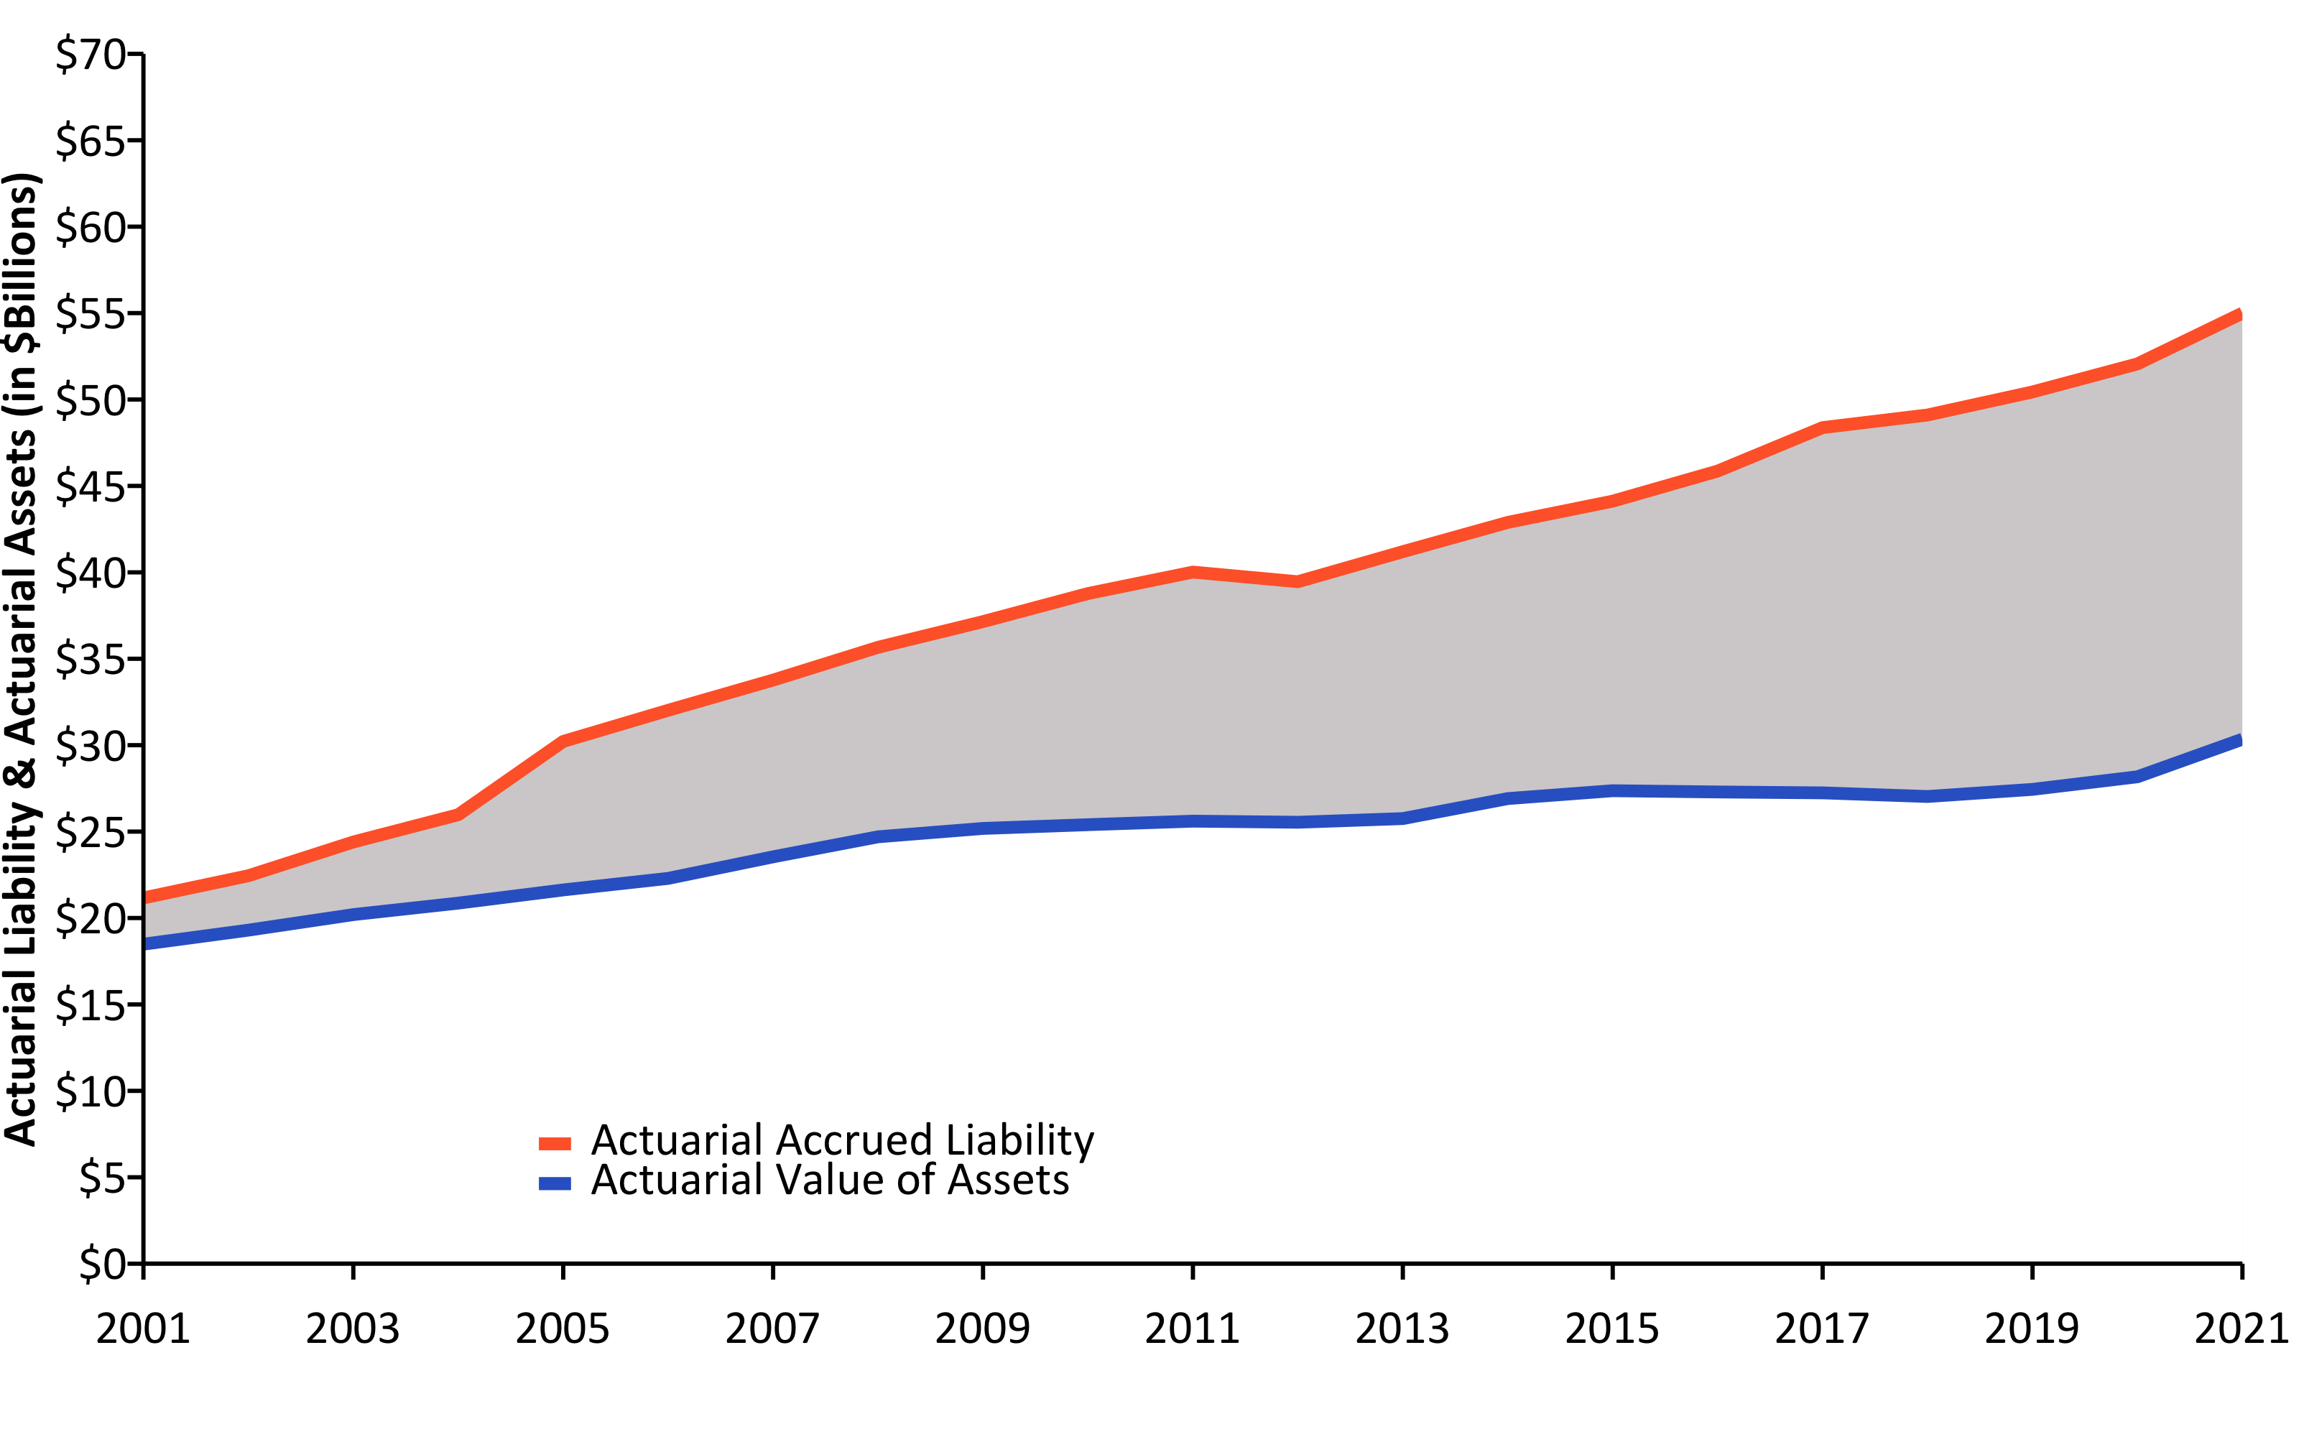
Liabilities Growing Faster than Assets (2001-2021) w/ R (linePlot())
Source: Pension Integrity Project analysis of SCRS actuarial valuation reports.

Slide 6
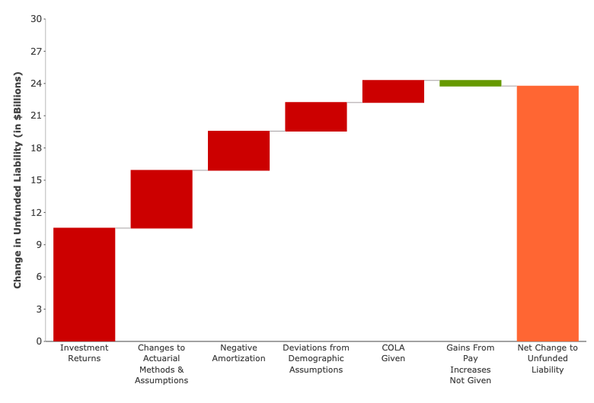
Causes of Pension Debt (2002-2020) w/ R (custom Plotly-Image)

Slide 7
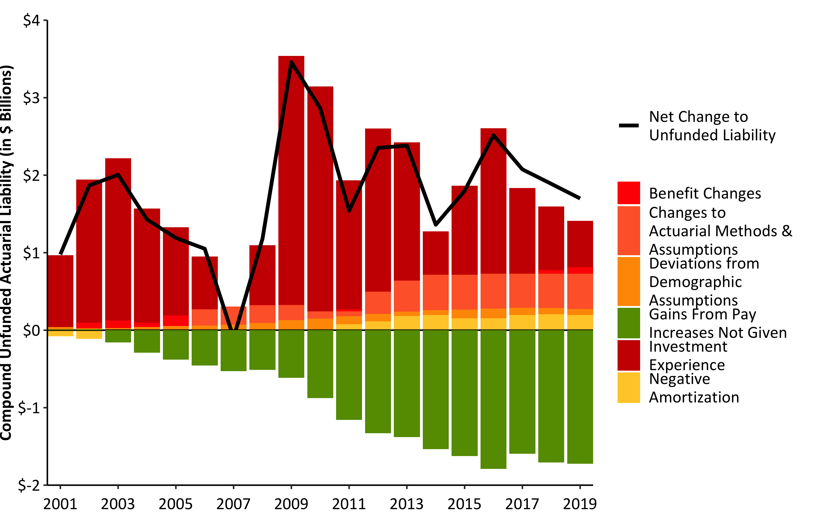
Compound Net Change to UAL w/ R (barPlot())
Source: Pension Integrity Project analysis of SCRS actuarial valuation reports.

Slide 8
Make up of Pension Contributions w/ R (flextable())
FY2023 Contributions | FY2023 Contributions | FY2023 Contributions
Contribution Type | % of Payroll | $ Value
Total Employee | 9.0% | $932,014,000
Total Employer | 17.6% | $1,742,976,450
Employer (Debt Amortization) | 15.6% | $1,549,422,687
Employer (Normal Cost) | 2.0% | $193,553,763
Total SCRS Contributions | 26.6% | $2,636,301,510

Slide 9
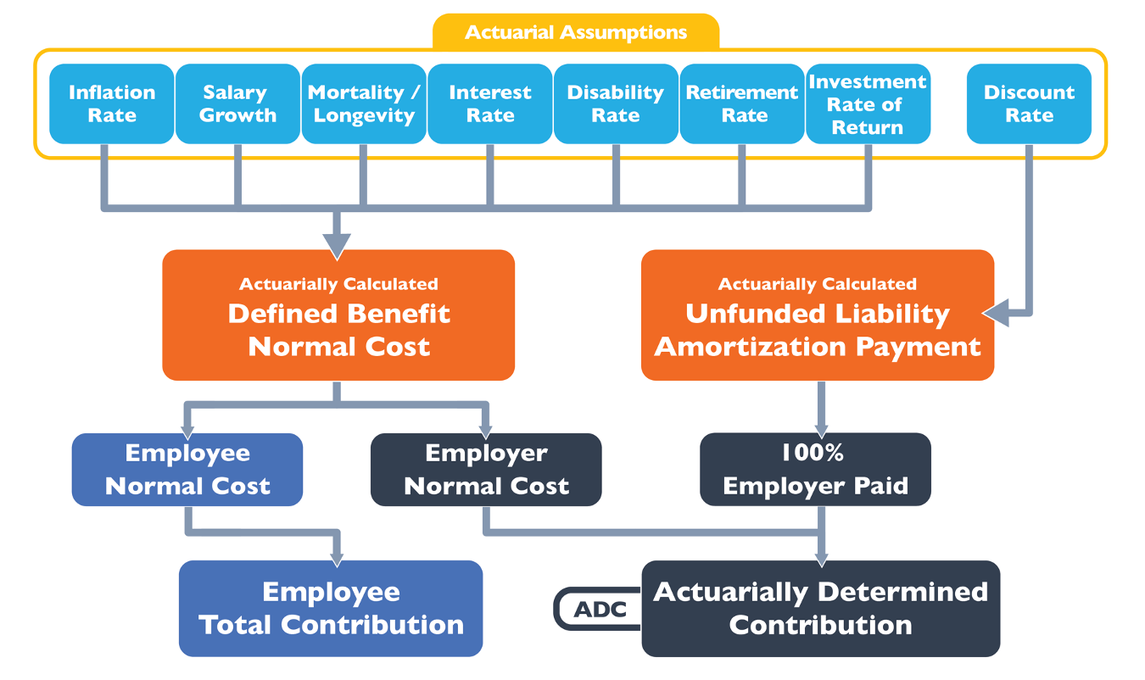
How a Pension Plan is Funded w/ Image

Slide 10
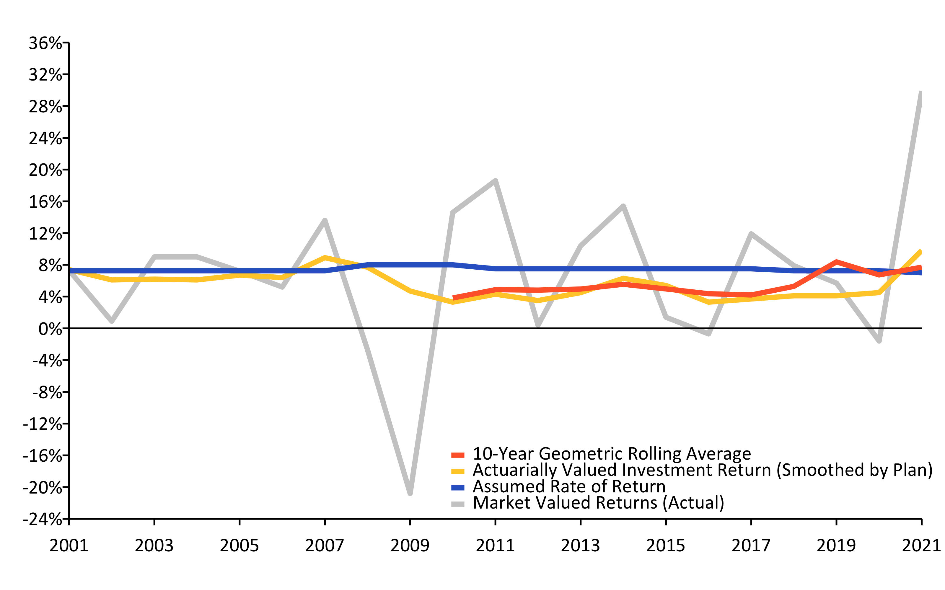
A History of Investment Returns (2001-2021) w/ R (linePlot())
Source: Pension Integrity Project analysis of SCRS actuarial valuation reports.

Slide 11
Investment Returns vs. Assumptions w/ R (flextable)
Year | Average Market Valued Returns | Average Actuarially Valued Returns
20-Years (2002-2021) | 6.3% | 5.50%
15-Years (2007-2021) | 6.3% | 5.20%
10-Years (2012-2021) | 7.7% | 4.90%
5-Years (2017-2021) | 10.3% | 5.20%

Slide 12
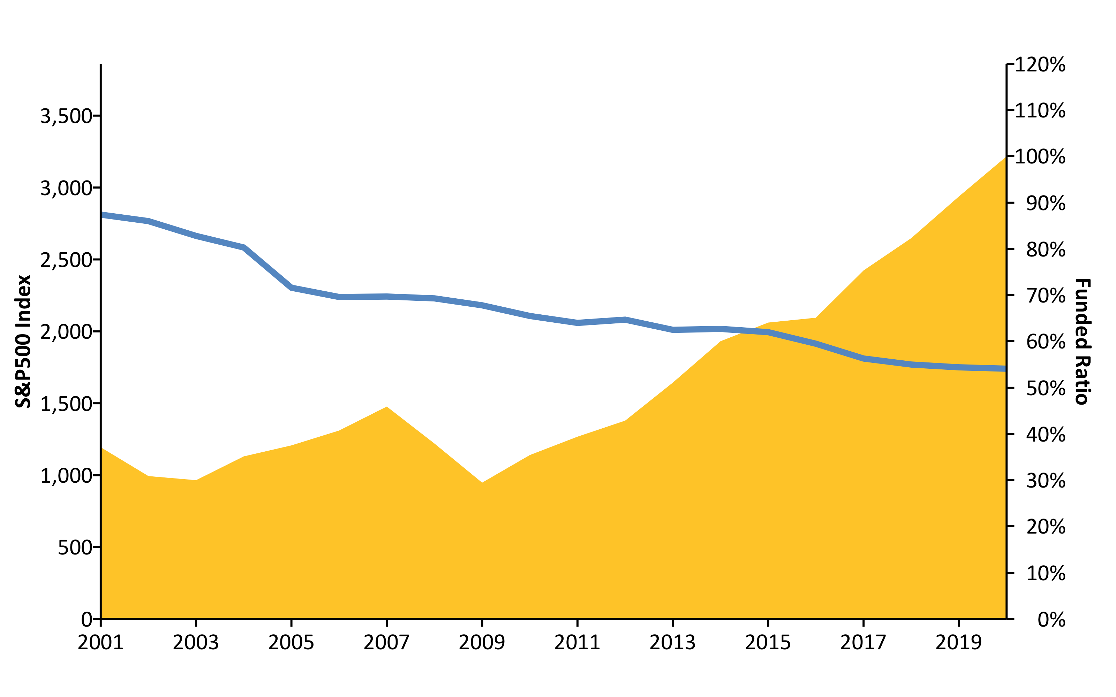
S&P500 vs. Funded Ratio (2001-2020) w/ R (areaPlot())
Source: Pension Integrity Project analysis of SCRS actuarial valuation reports.

Slide 13
New Normal: The Market Has Changed
The “new normal” for the institutional investing suggests that achieving even a 6% average rate of return is optimistic.
Over the past two decades there has been a steady change in the nature of the institutional investment returns.
30-year Treasury yields have fallen from around 8% in the 1990s to consistently less or around 3% today.
Globally, interest rates are at the ultralow historic levels, while market liquidity continues to be restrained by financial regulations.
McKinsey & Co. forecast the returns to equities will be 20% to 50% lower over the next two decades compared to the previous three decades.
Using their forecast, the best-case scenario for a 60/40 portfolio of equities and bonds is likely to earn less than a 5% return.
As FR waits for the “recover” its unfunded liabilities continue to grow.

Slide 14
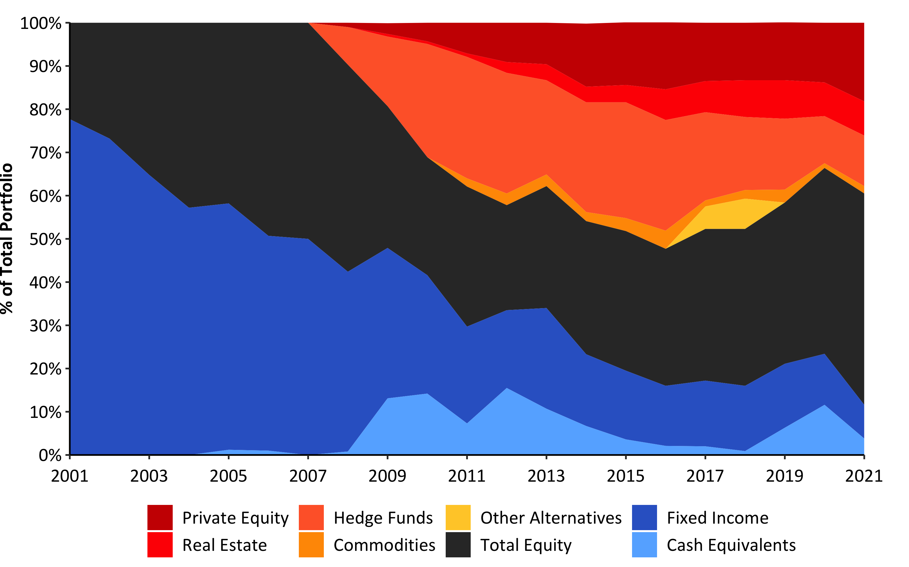
Asset Allocation (2001-2021) w/ R (custom)
Source: Pension Integrity Project analysis of SCRS actuarial valuation reports.

Slide 15
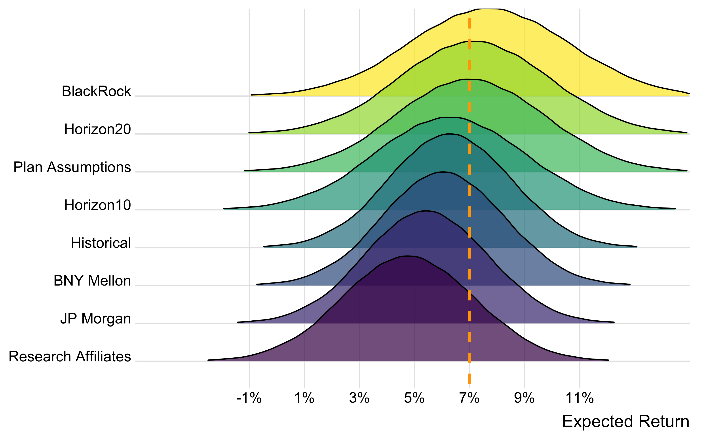
Probability Analysis w/ R (flextable())
Source: Pension Integrity Project Monte Carlo model based on SCRS asset allocation and reported expected returns by asset class. Forecasts of returns by asset class generally by BNYM, JPMC, BlackRock, Research Affiliates, and Horizon Actuarial Services were matched to the SCRS specific asset class. Probability estimates are approximate as they are based on the aggregated return by asset class. For complete methodology contact Reason Foundation.

Slide 16
Possible Rates of Return | Based on SCRS Assumptions | SCRS Historical Returns | Research Affiliates 10-Year Forecast | BNY Mellon 10-Year Forecast | Horizon 10-Year Market Forecast | JP Morgan 10-15 Year Forecast | Horizon 20-Year Market Forecast | BlackRock 20-Year Forecast
9 % | 23.3% | 11.1% | 3.8% | 5.5% | 9.2% | 16.0% | 25.1% | 32.8%
8 % | 35.8% | 22.0% | 8.9% | 12.5% | 18.9% | 26.4% | 38.0% | 45.9%
7 % | 50.1% | 37.3% | 17.6% | 24.1% | 33.3% | 39.6% | 52.4% | 59.7%
6.5 % | 57.5% | 46.1% | 23.5% | 31.6% | 41.8% | 46.8% | 59.7% | 66.2%
6 % | 64.5% | 55.1% | 30.4% | 39.8% | 50.7% | 54.1% | 66.6% | 72.3%
5.5 % | 71.1% | 63.8% | 37.9% | 48.6% | 59.7% | 61.3% | 73.0% | 77.7%
5 % | 77.0% | 71.9% | 46.1% | 57.5% | 68.2% | 68.2% | 78.7% | 82.6%

Slide 17
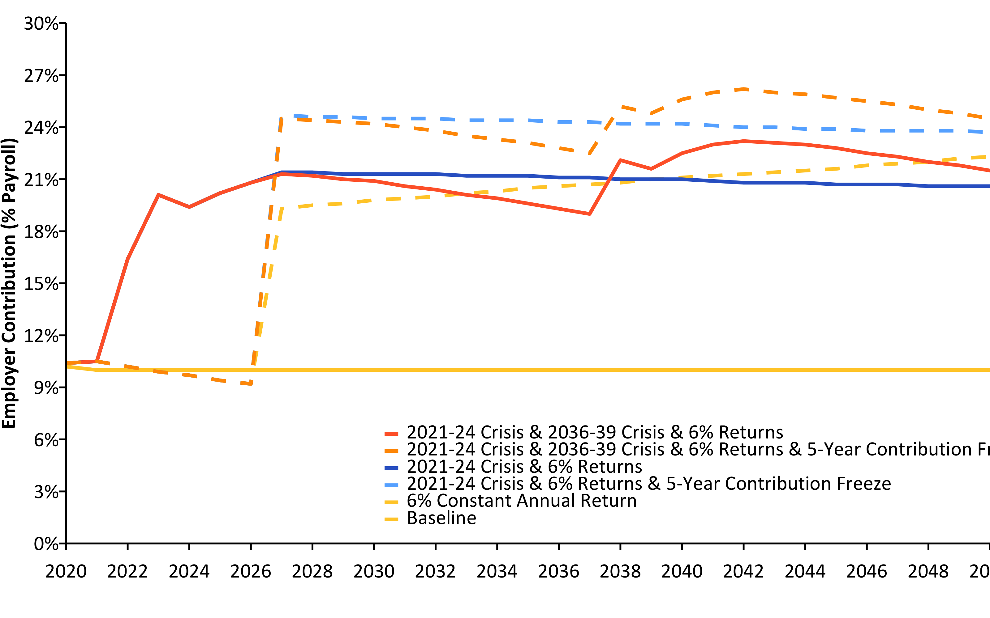
Current Contributions Are Actuarially Insufficient (2020-2050) w/ R (linePlot())
Source: Pension Integrity Project actuarial forecast of SCRS.

Slide 18
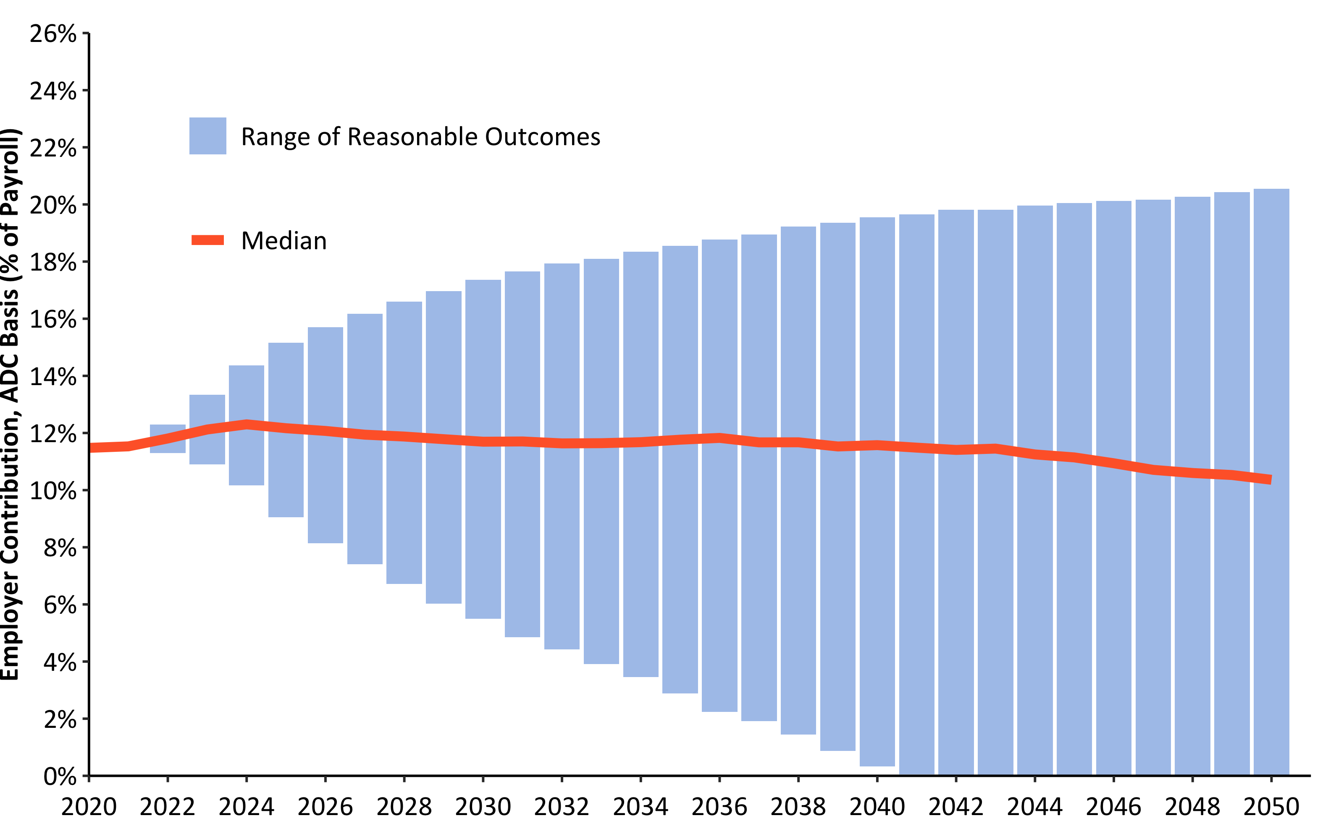
30-Year Employer Contribution Forecast w/ R (barPlot())
Source: Pension Integrity Project actuarial forecast of SCRS.

Slide 19
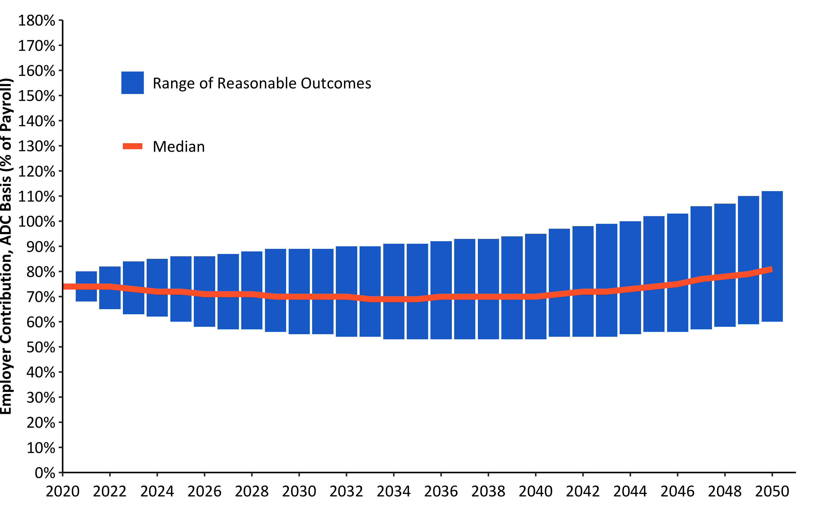
30-Year Funded Ratio Forecast w/ R (barPlot())
Source: Pension Integrity Project actuarial forecast of SCRS.

Slide 20
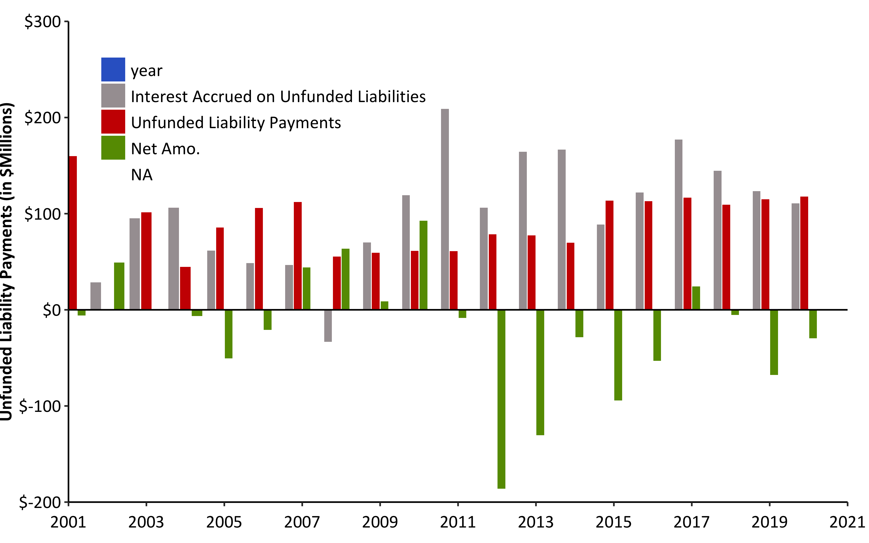
Debt Interest vs. Unfunded Liability Payments (2001-2021) w/ R (w/ barPlot())
Source: Pension Integrity Project analysis of SCRS actuarial valuation reports.

Slide 21
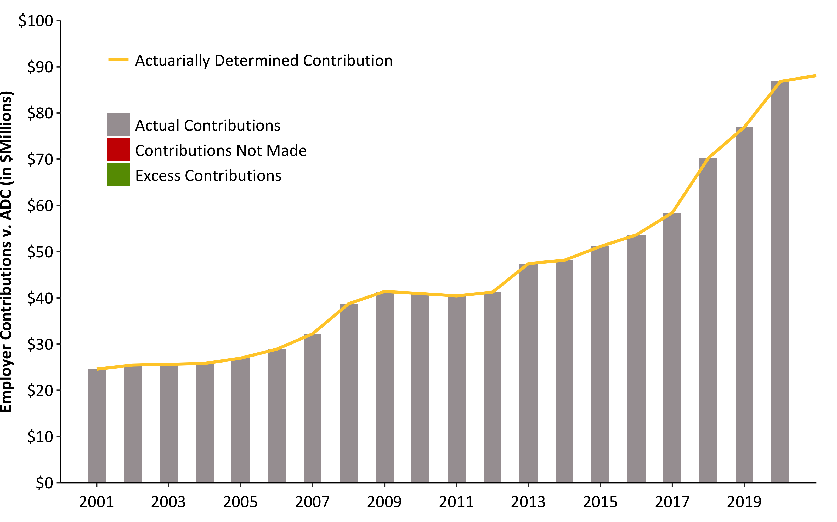
ADEC Contribution History (2001-2020) w/ R (barPlot())
Source: Pension Integrity Project analysis of SCRS actuarial valuation reports.

Slide 22
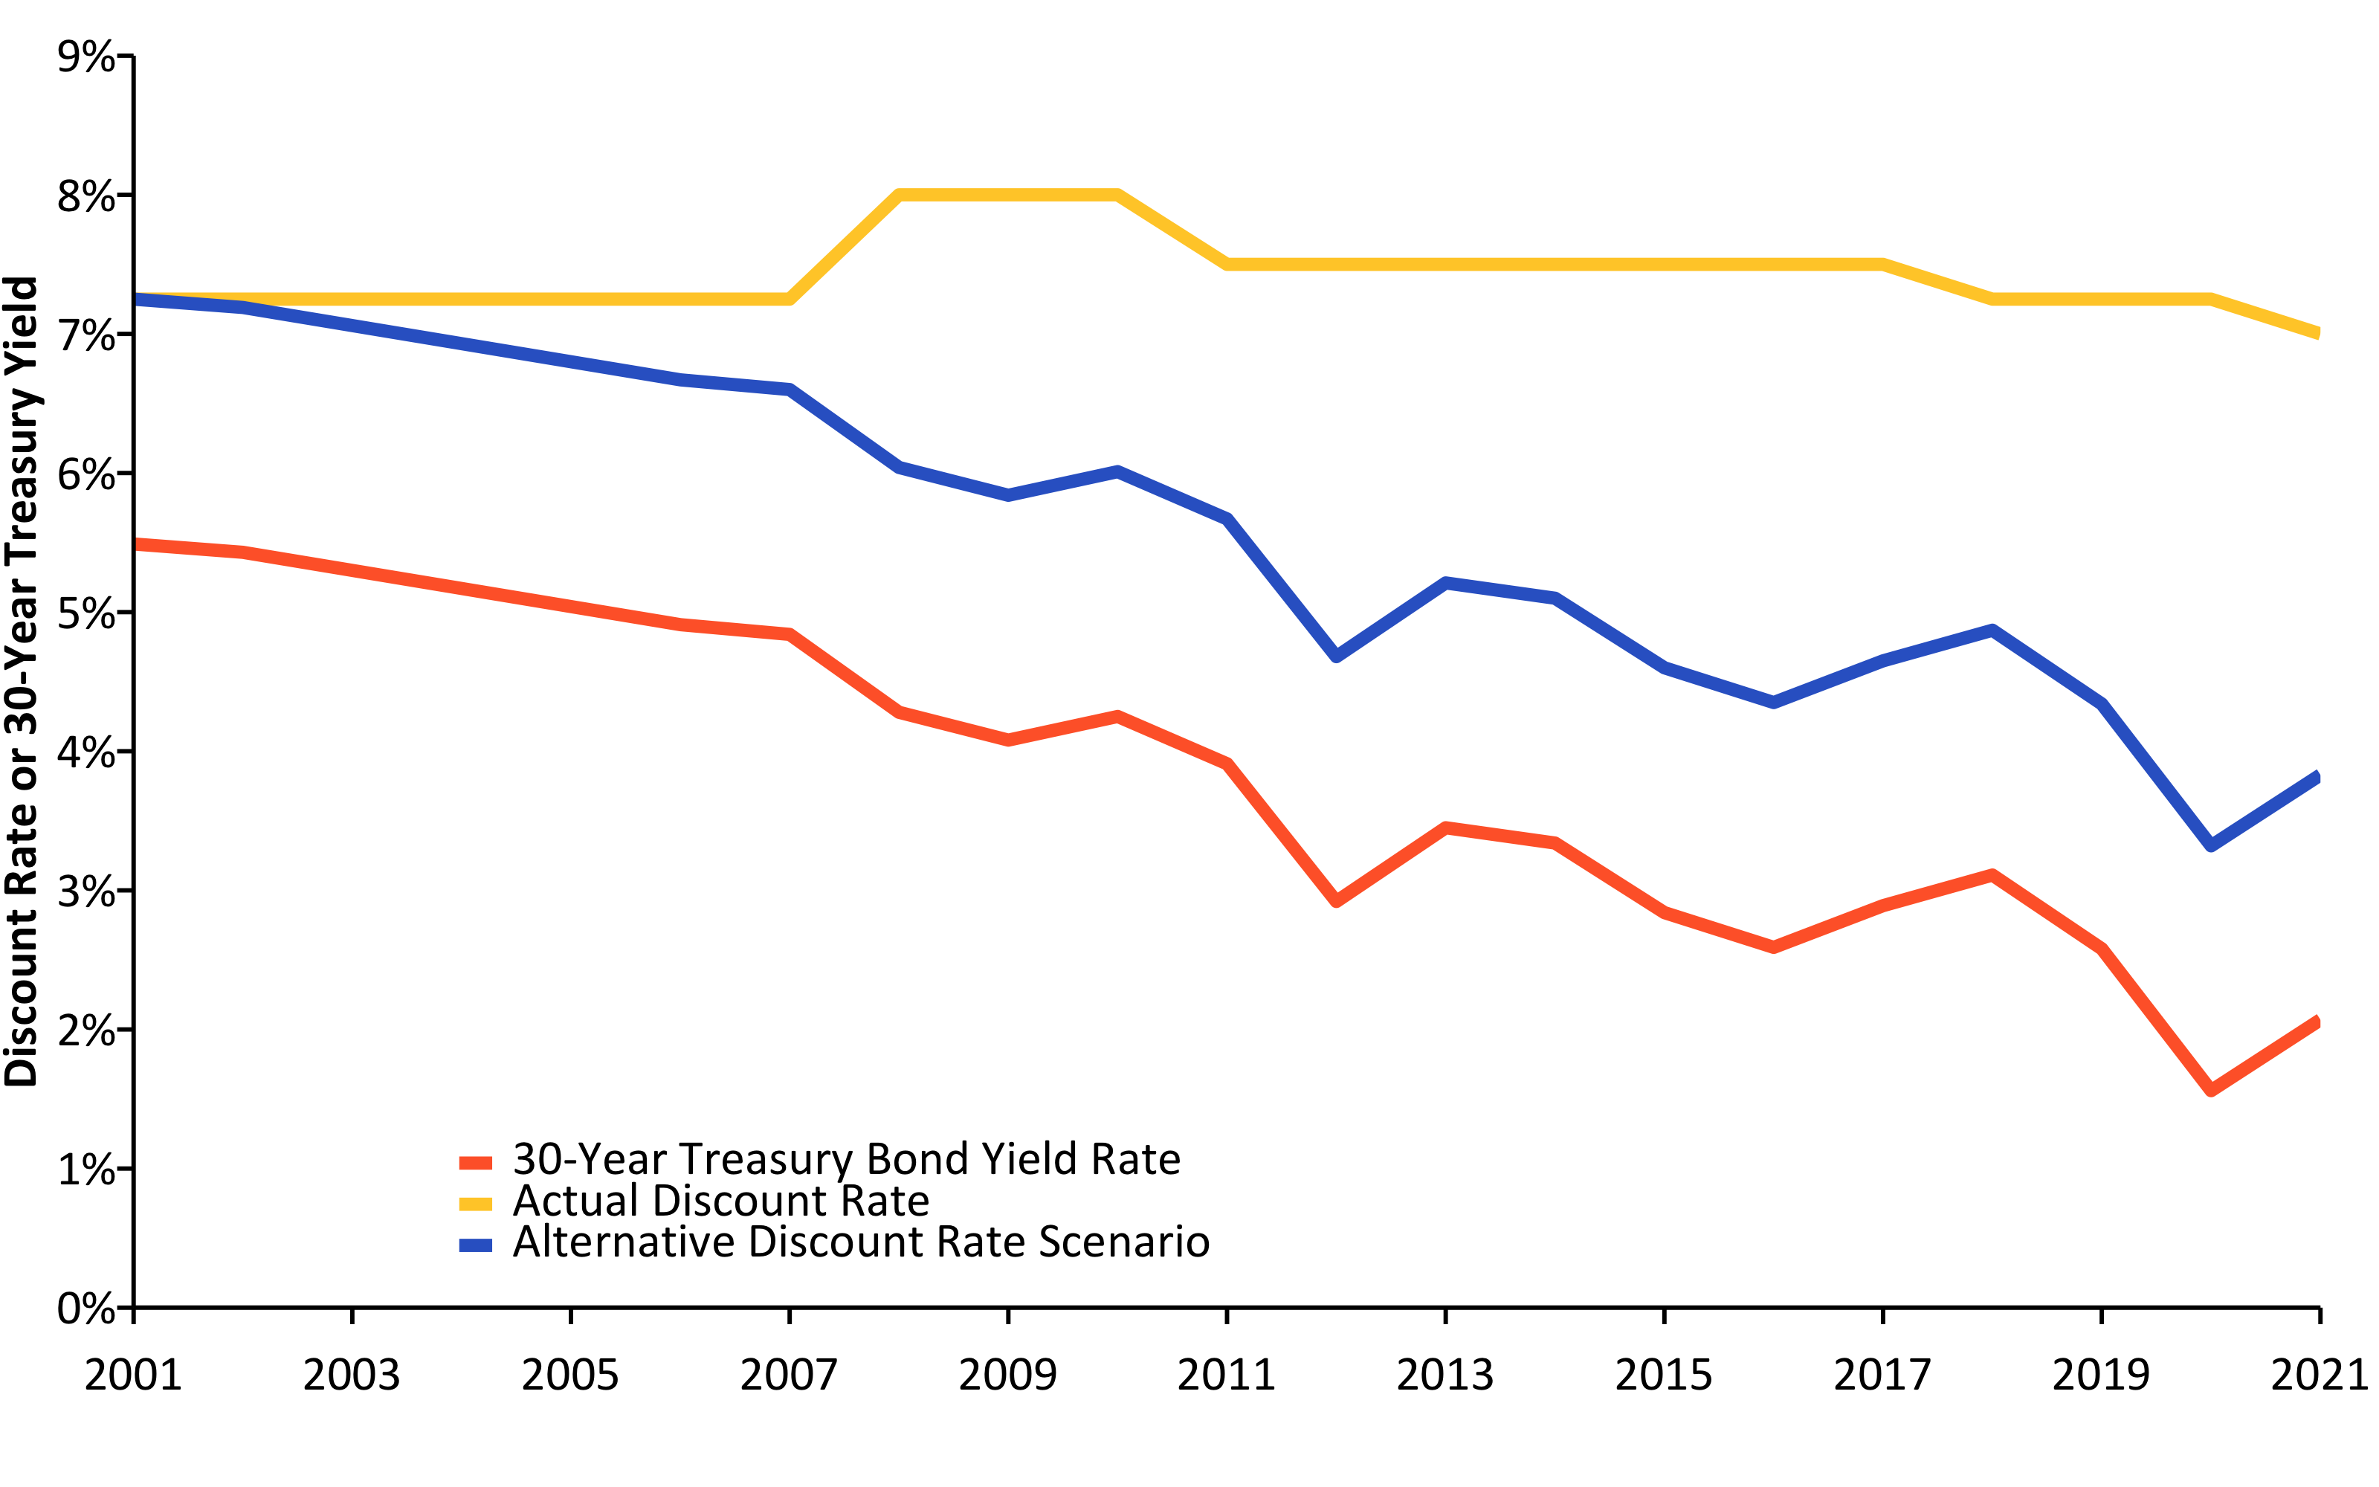
Change in Risk-Free Rate vs. Discount Rate (2001-2021) w/ R (linePlot())
Source: Pension Integrity Project analysis of SCRS actuarial valuation reports.

Slide 23
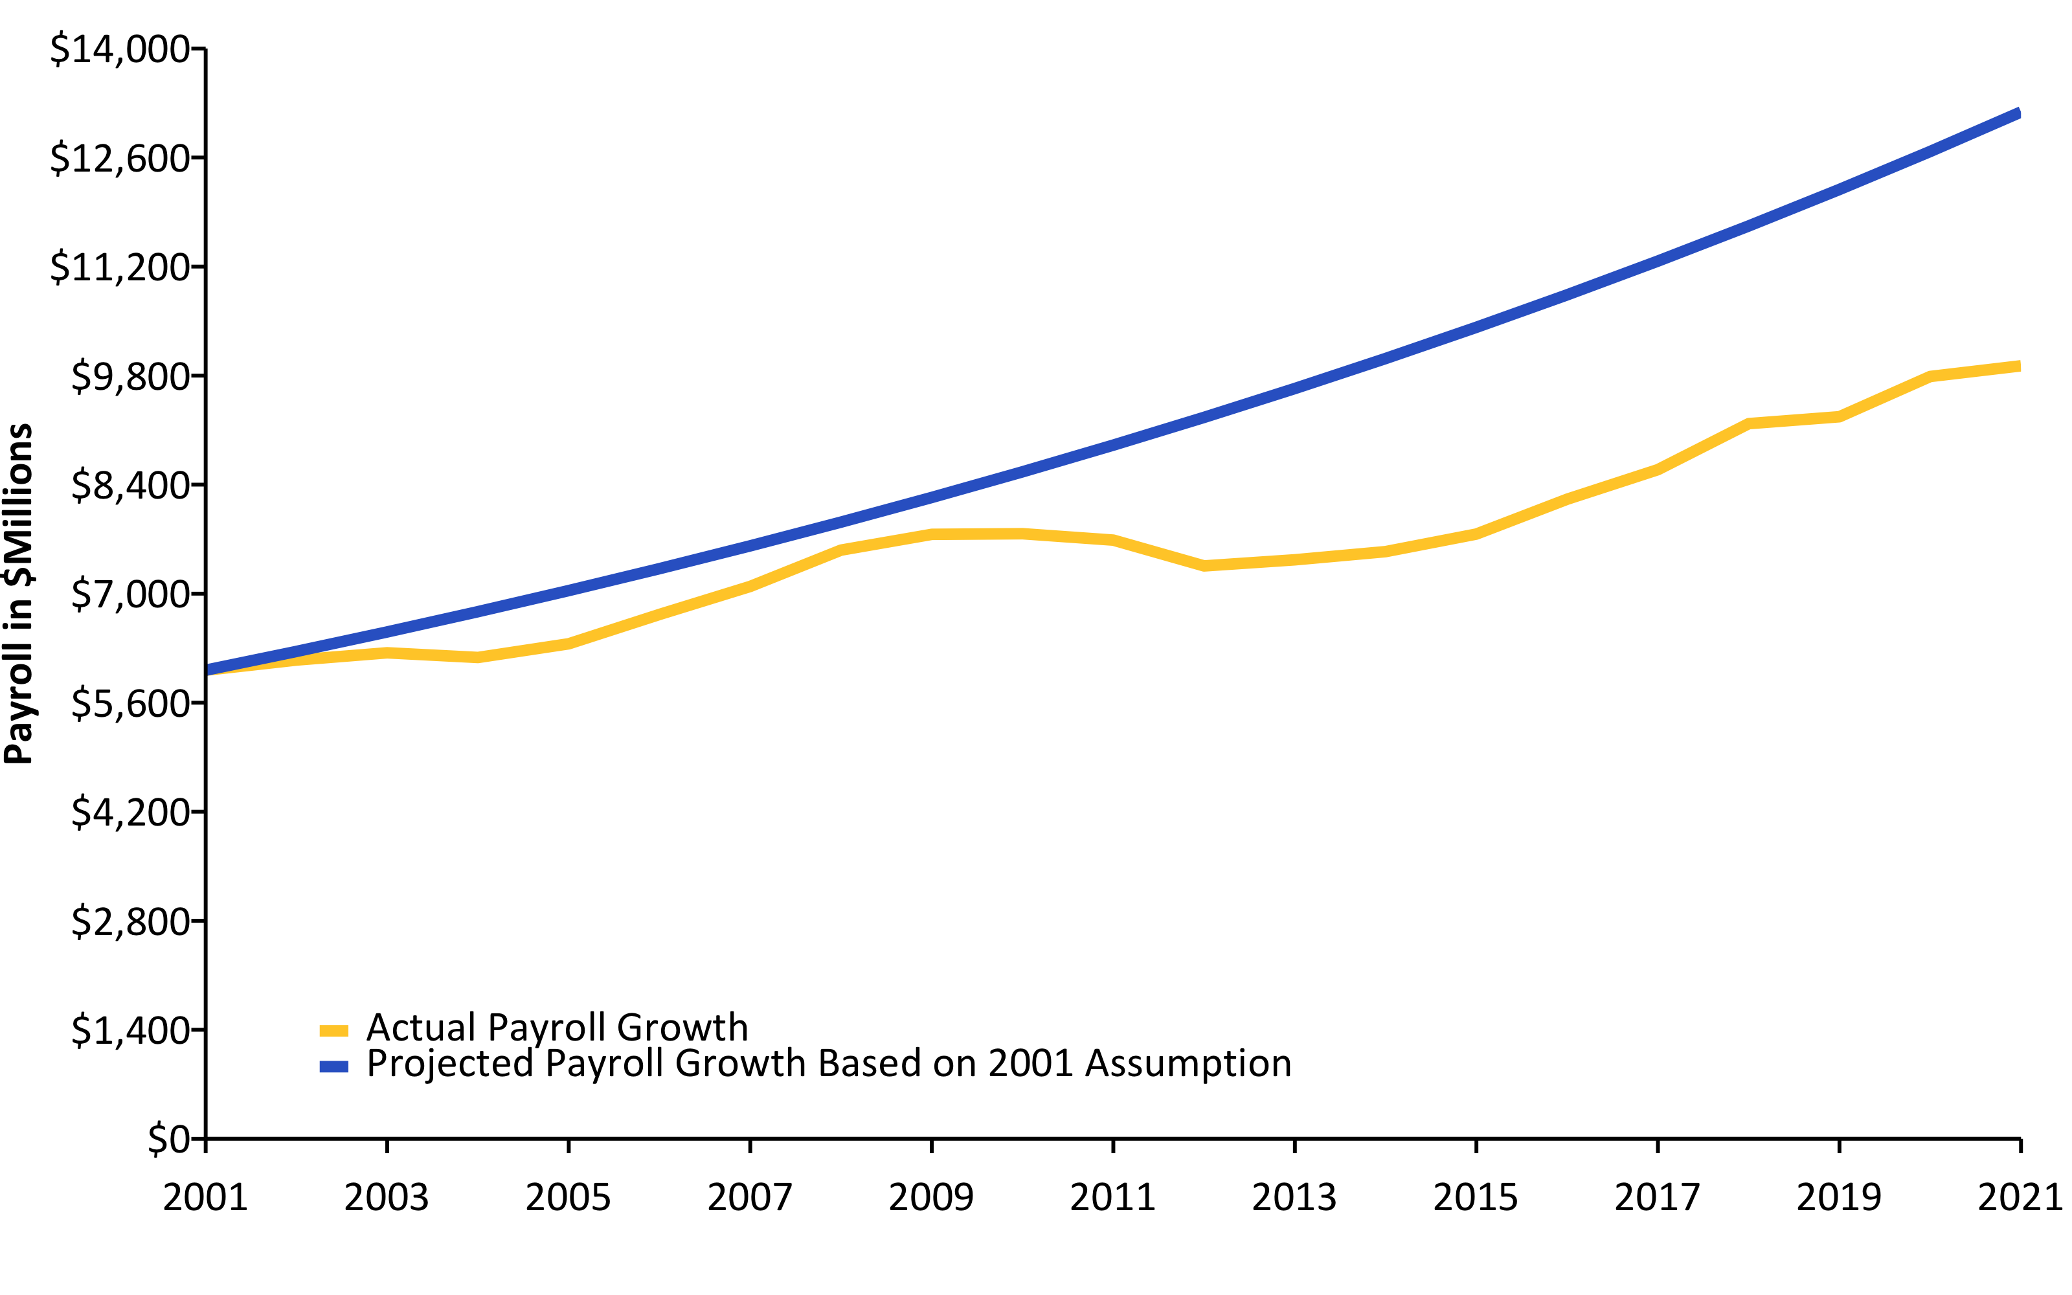
Actual Change in Payroll vs. Assumption (2001-2021) w/ R (linePlot())
Source: Pension Integrity Project analysis of SCRS actuarial valuation reports.

Slide 24
Actual Inflation vs. Assumption (2001-2020) w/ R (linePlot())
## Response [https://raw.githubusercontent.com/ReasonFoundation/databaseR/master/files/CPI_by_Region_DOL.xlsx] ## Date: 2021-12-23 19:30 ## Status: 200 ## Content-Type: application/octet-stream ## Size: 13.8 kB ## <ON DISK> /var/folders/0z/p5zgjmbn6531bgclzwc383500000gn/T//RtmpdkODKt/file17a91e007ae2.xlsx

Slide 25
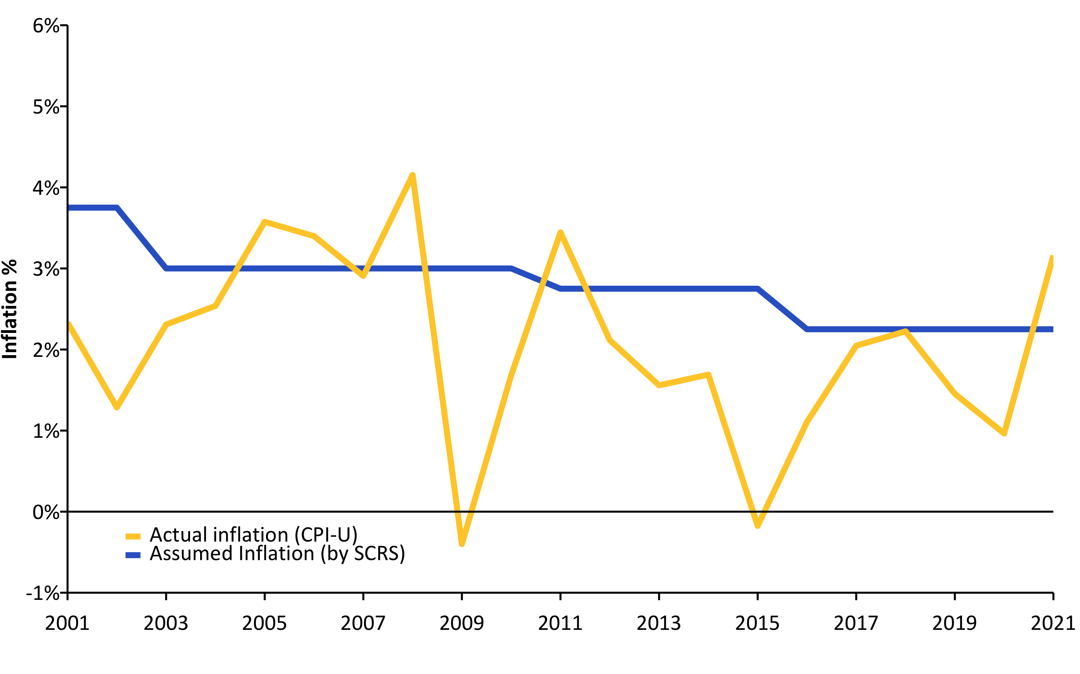
Source: Pension Integrity Project analysis of SCRS actuarial valuation reports.

Slide 26
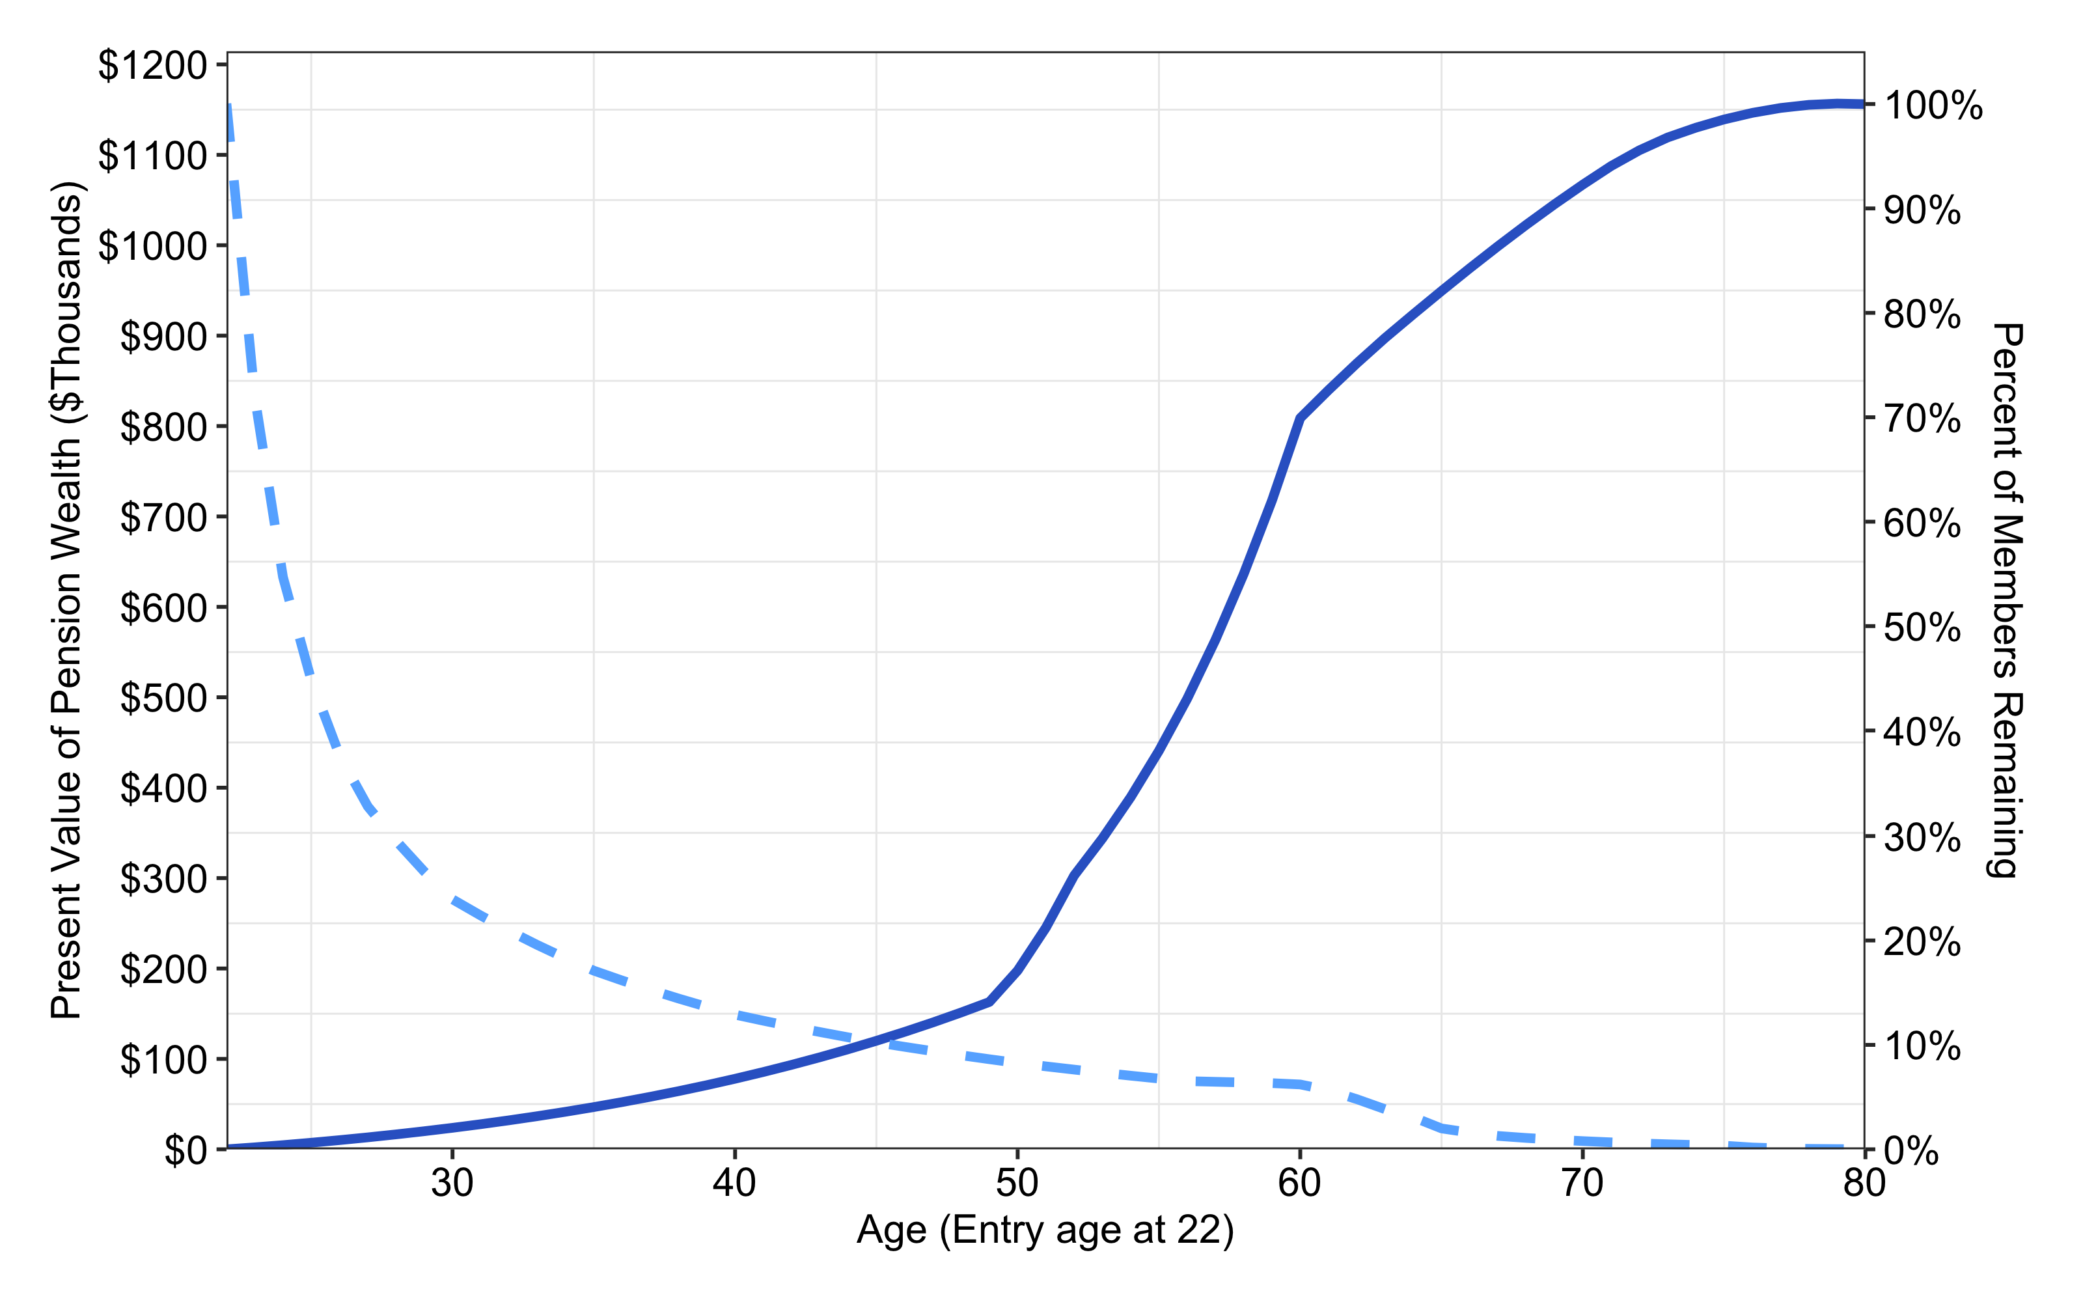
Benefit Accrual & Retention for New SCRS Employee w/ R (custom)
Source: Pension Integrity Project analysis of SCRS actuarial reports and CAFRs. Illustration is based on plan’s Tier 2, Tier 3, Tier 4 assumptions and a hypothetical analysis of an average member hired at the age of 25

Slide 27
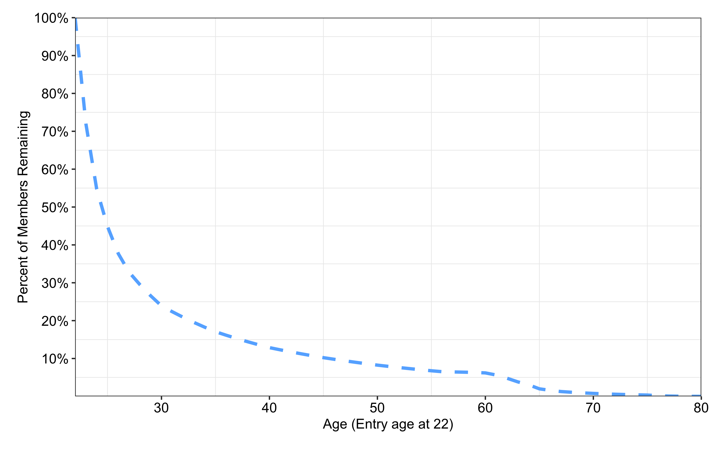
Retention Rates for a New SCRS Employee w/ R (custom)
Source: Pension Integrity Project analysis of SCRS actuarial reports and CAFRs. Illustration is based on plan’s Tier 2, Tier 3, Tier 4 assumptions and a hypothetical analysis of an average member hired at the age of 25

Slide 28
Retention: Only Few of 22 Age New SCRS Hires Receive Benefits
- Only 37.7% of new SCRS employees will stay for 8 years to vest.
- And only 12.3% of the same employees will be on the job after 34 years needed to qualify for full retirement

Slide 29
References
https://github.com/ReasonFoundation/GraphicsR
https://rstudio.com/wp-content/uploads/2015/03/rmarkdown-reference.pdf
https://bookdown.org/yihui/rmarkdown/

